Slide 1


Sri Krishna Arts and Science College Coimbatore
Department of Software Systems and AIML
Name : ASLINA ANJUM I
Register Number : 24BAI110
III B.Sc. AIML
Semester V
INDUSTRIAL EXPOSURE TRAINING
24CSS28
TOPIC :
DIABETES PREDICTION
Under the Guidance of Dr. M. RAJU, M.Sc., Ph.D.,

Slide 2
INTRODUCTION
➢ Tech volt Software Pvt. Ltd. is an IT services and software development company located in Coimbatore, Tamil Nadu.
➢ The company provides services such as web development, mobile application development, AI/ML solutions, and cloud-based software services.
➢ Tech volt uses modern technologies like Python, TensorFlow, React, MySQL, and cloud platforms for developing intelligent software applications.
➢ The company focuses on delivering high-quality, secure, and user-friendly AI-powered solutions for healthcare and other business sectors.
➢ Tech volt follows agile development methods and quality standards to ensure efficient, reliable, and scalable project development.

Slide 3
COMPANY PROFILE
➢ Company Name : Tech volt Software Pvt. Ltd.
➢ Established in 2018 and located in Coimbatore, Tamil Nadu.
➢ Tech volt is an ISO 9001:2015 certified IT services and consulting company.
➢ The company provides software development, AI/ML solutions, web development, cloud services, and IT consulting.
➢ Tech volt focuses on delivering innovative, scalable, and client-friendly intelligent software applications.

Slide 4
SYSTEM SPECIFICATION
Tech volt uses Intel Core i7/i9 processors with 32 GB RAM for AI model training and software development.
Operating systems such as Windows 11 and Ubuntu Linux are used based on project and deployment requirements.
Development tools like VS Code, Jupyter Notebook, GitHub, Docker, and Anaconda are used for AI application development.
Tech volt uses cloud platforms along with high-speed networking, for secure and efficient AI deployments.
SKASC
5

Slide 5
HIGHLIGHTS OF THE COMPANY
One of the fast-growing IT companies in Coimbatore, specializing in AI, Machine Learning, Web Development, and Cloud Computing.
ISO 9001:2015 Certified company delivering high-quality and reliable software solutions.
Develops innovative AI-powered applications for healthcare, education, and business automation.
Uses modern technologies such as Python, TensorFlow, Scikit-learn, React, Docker, and AWS.
Follows Agile Development Methodology to ensure efficient project management and timely delivery.
Provides Industrial Exposure Training (IET), internships, and real-time project experience for students.

Slide 6
DEPARTMENTS OF THE COMPANY
AI/ML Research Department – Handles machine learning model development and data science projects.
Software Development Department – Builds web, mobile, and enterprise software applications.
Quality Assurance Department – Tests applications and validates AI model accuracy and software quality.
Data Engineering Department – Manages data pipelines, preprocessing, and database architecture.
Customer Support Department – Provides technical support, client onboarding, and project assistance.

Slide 7
SPECIALIZED DEPARTMENT
AI / ML RESEARCH DEPARTMENT
Conducts research on Artificial Intelligence (AI) and Machine Learning (ML) technologies.
Develops and trains machine learning models using data to make accurate predictions.
Collects, processes, and analyses data to improve the performance of AI systems.
Uses tools and programming languages such as Python, TensorFlow, Scikit-learn, and Pandas for AI development.
Creates AI-based solutions for real-world applications in healthcare, finance, education, automation, and business.

Slide 8
ABOUT MY PROJECT :
DIABETES PREDICTION SYSTEM
The Diabetes Prediction System is an AI-based application developed using Python and machine learning algorithms.
The project predicts the likelihood of diabetes in patients using medical parameters like glucose level, BMI, and blood pressure.
The application processes patient health data and applies trained ML models to generate accurate risk predictions.
The system provides early-stage diagnosis support, enabling timely medical intervention and better patient outcomes.
The project features a user-friendly web interface that allows healthcare professionals to input data and view predictions easily.

Slide 9
CONCLUSION
The Diabetes Prediction System was successfully developed using Python and machine learning algorithms.
The application enables accurate early-stage diabetes risk prediction based on patient health parameters.
The project enhanced my knowledge in data preprocessing, machine learning model development, and web deployment.
The system provides a simple, interactive, and clinically useful tool for supporting healthcare professionals.
This project demonstrated the real-world impact of AI in healthcare and strengthened my practical understanding of data science.
.

Slide 10
FUTURE ENHANCEMENT
Integrate deep learning models such as Neural Networks for improved diabetes prediction accuracy.
Add support for real-time patient data input via wearable health devices and IoT sensors.
Develop a mobile application version for Android and iOS to enable on-the-go health monitoring.
Implement multi-disease prediction capabilities covering hypertension, heart disease, and kidney conditions.
Add explainability features (e.g. SHAP values) to help doctors understand model predictions in clinical settings.

Slide 11
BIBLIOGRAPHY
Python Documentation – https://docs.python.org/3/
Scikit-learn Documentation – https://scikit-learn.org/stable/
TensorFlow Documentation – https://www.tensorflow.org/
Pandas Documentation – https://pandas.pydata.org/
NumPy Documentation – https://numpy.org/
Flask Documentation – https://flask.palletsprojects.com/
Matplotlib Documentation – https://matplotlib.org/
Jupyter Notebook Documentation – https://jupyter.org/
Pima Indians Diabetes Database – https://www.kaggle.com/datasets/uciml/pima-indians-diabetes-database
Ian Goodfellow, Yoshua Bengio, and Aaron Courville. Deep Learning. MIT Press, 2016.
Aurélien Gérn. Hands-On Machine Learning with Scikit-Learn, Keras & TensorFlow (3rd Edition). O'Reilly Media, 2022.

Slide 12
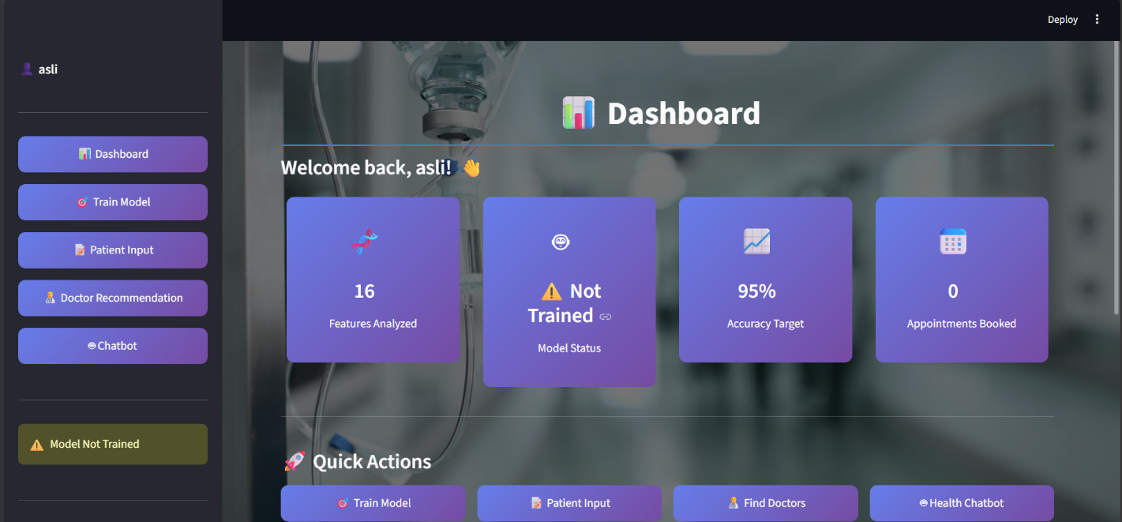
SAMPLE SCREENSHOTS

Slide 13
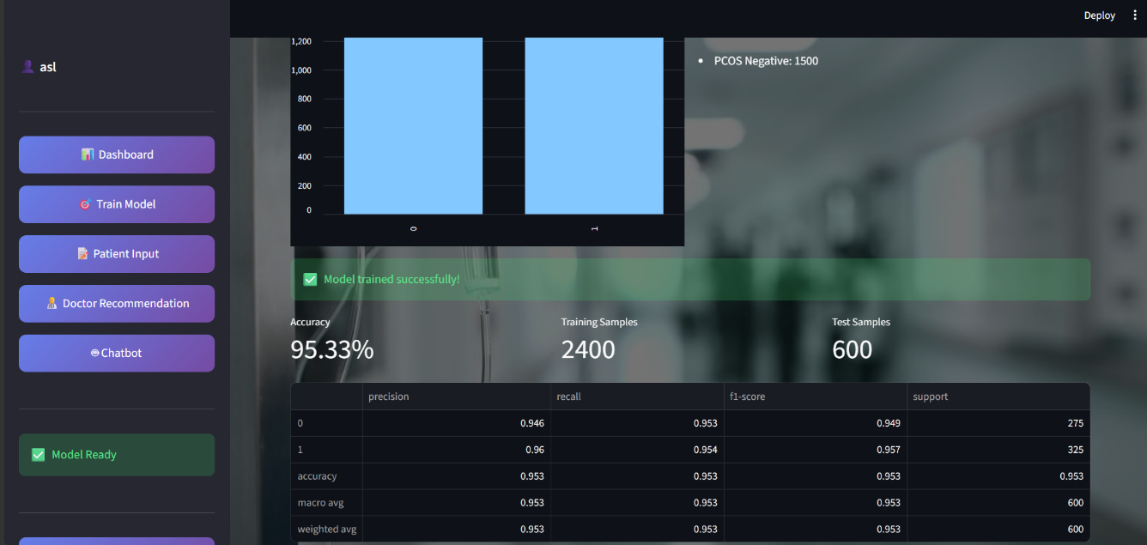
SAMPLE SCREENSHOTS

Slide 14
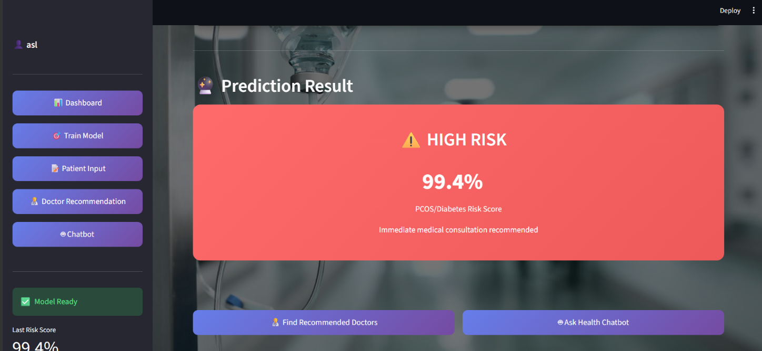
SAMPLE SCREENSHOTS

Slide 15
Thank you!
SKASCQ
18

